Slide 1
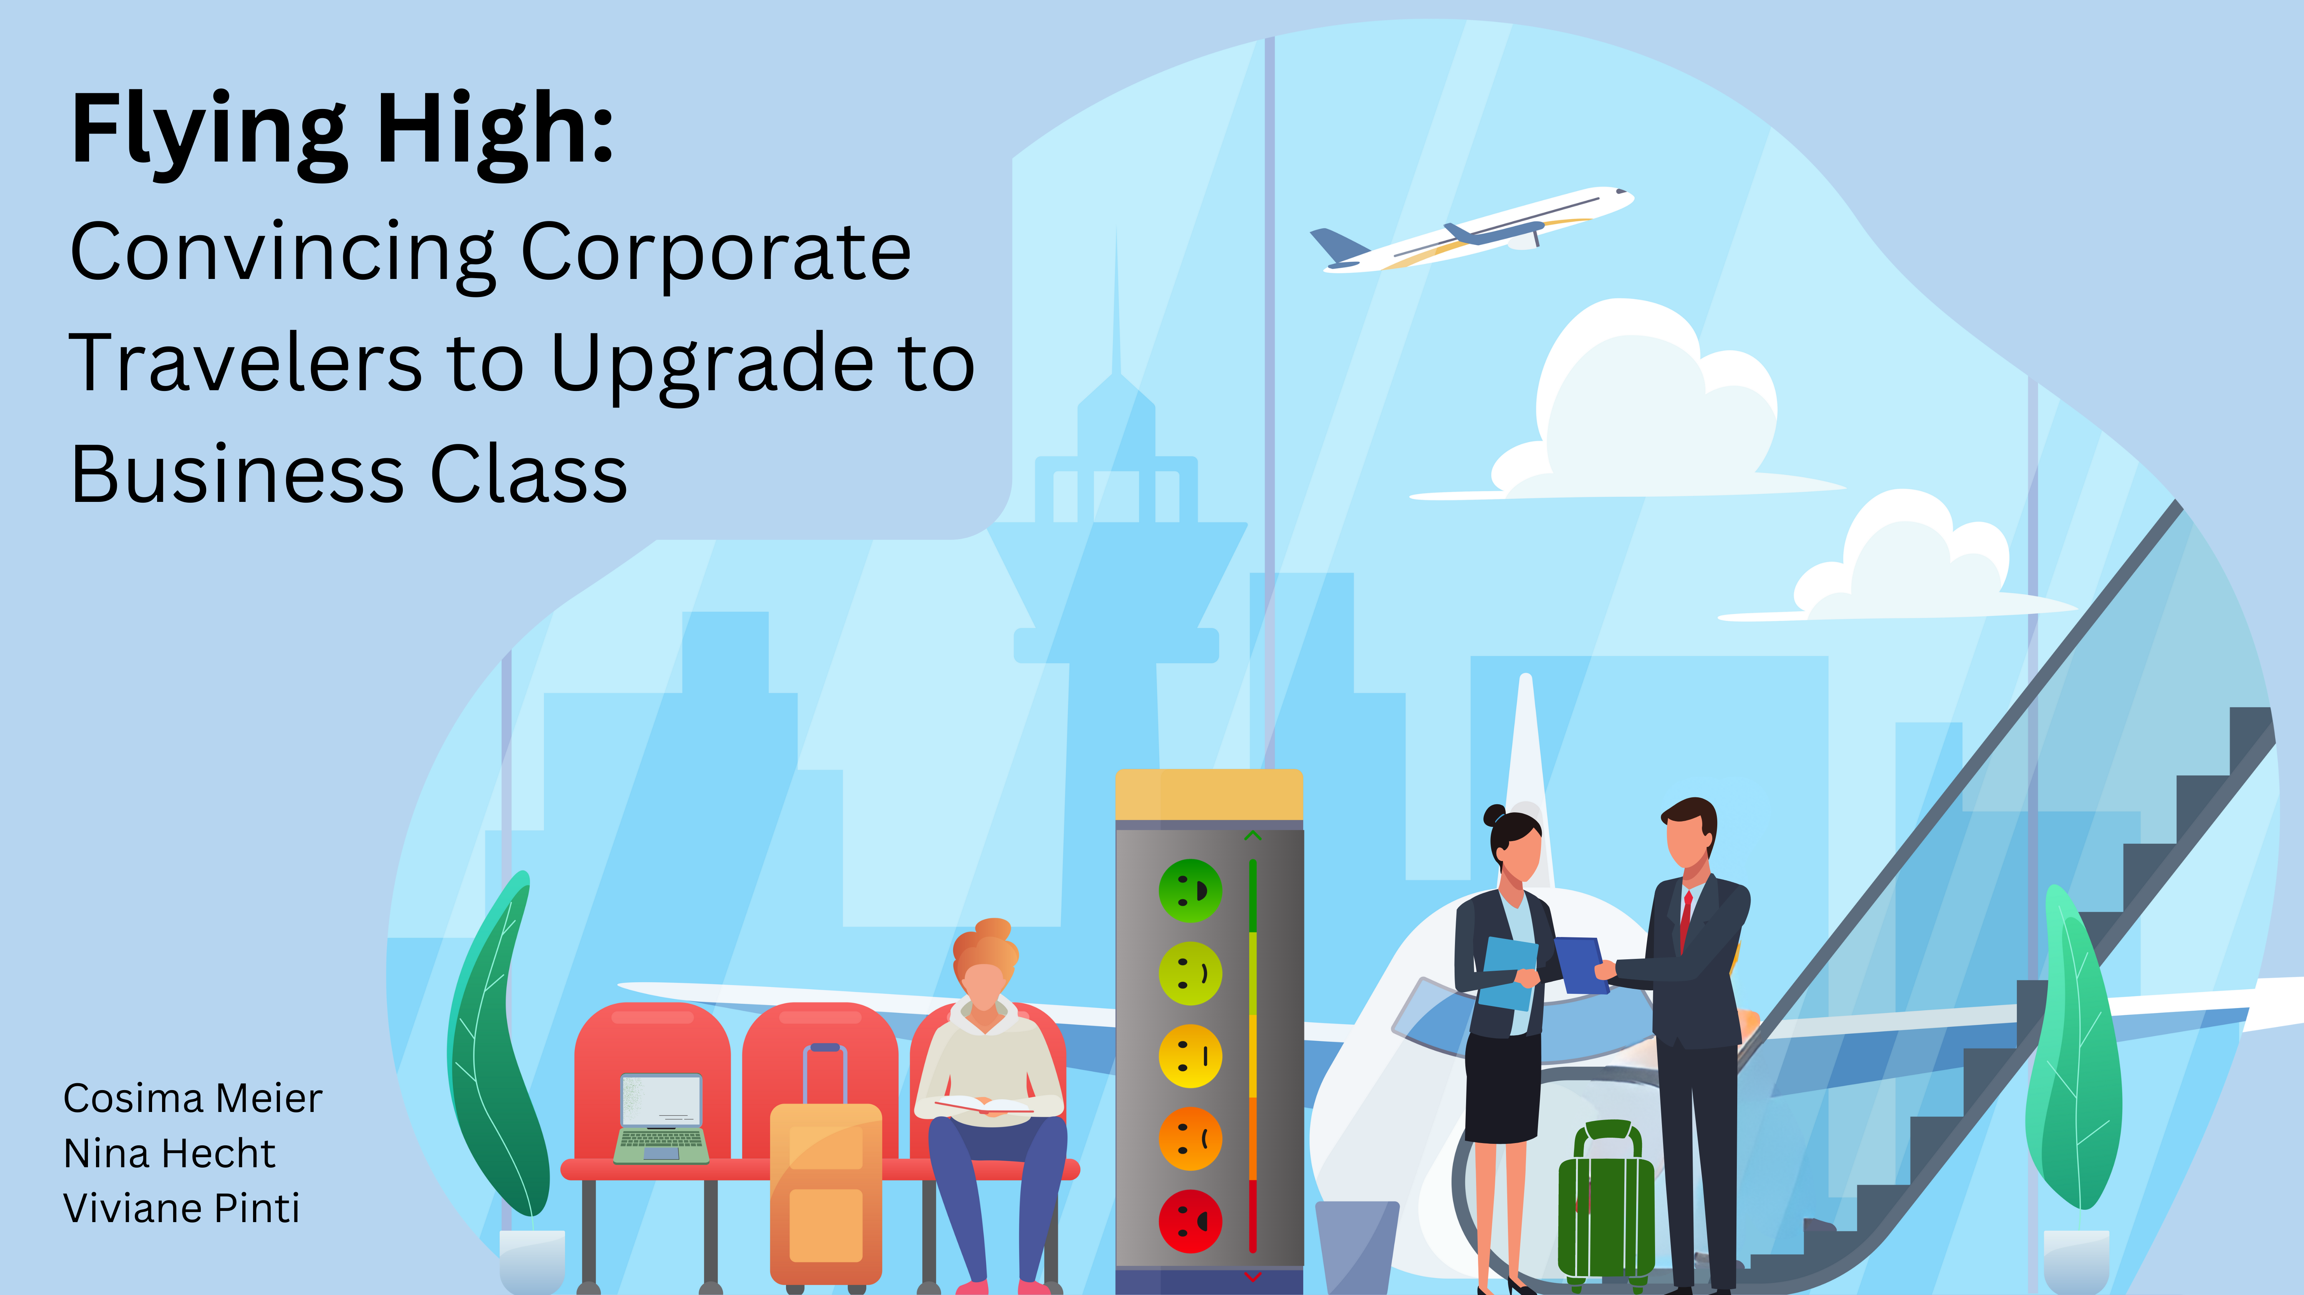

Slide 2
What aspects should the airline market to convince business travelers to upgrade from economy to business class?
Bild von Flugzeug mit 70% Profit
+ Upgrade to business!
Bild von Dataset
Dataset: 'US Airline passenger satisfaction’ 2015
Notes:
Research Aim + motivation
Are you looking to boost passenger satisfaction and increase profits for your airline? Look no further than your business class passengers and potential business class passengers. With 70% of your total profit coming from these passengers, it's clear that they're crucial to your success.
Given the potential decrease in air travel due to climate change, it becomes vital to focus on customer satisfaction in order to stay ahead of the competition.
Our aim is to identify which services should be marketed to corporate travelers flying economy class to convince them to upgrade to business class. By doing so, we can enhance passenger satisfaction and drive profits for your airline.
+ Dataset & Kategorien erklären!

Slide 3
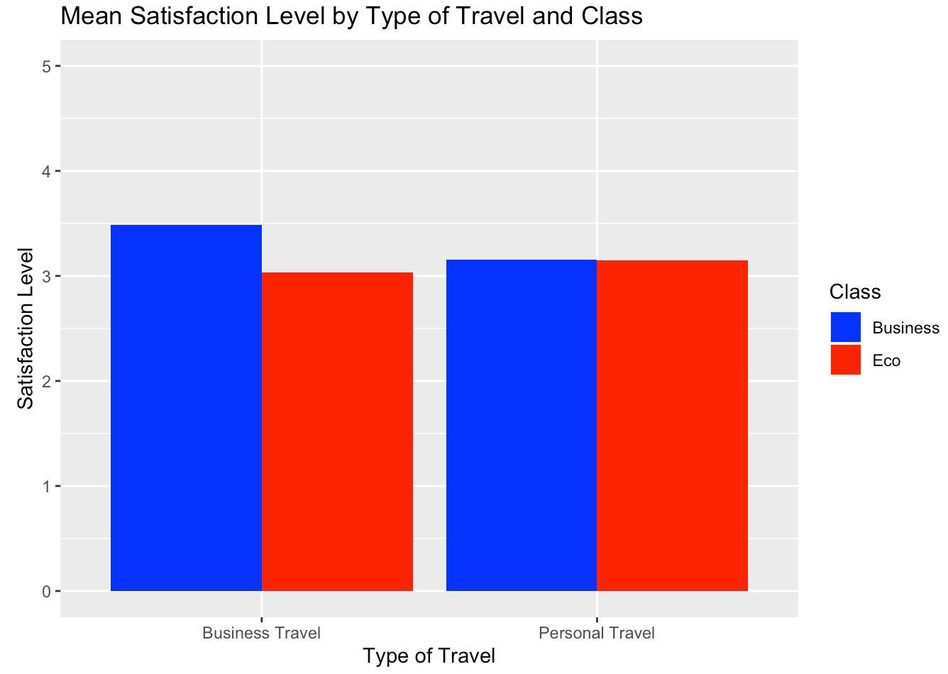
Notes:
Vorgehen + Methoden
first Insight:
Investigated the different mean satisfaction between corporate and personal travellers between Business and Eco class:
Corporate travelers were less satisfied in economoy class than personal travelers
Corporate travelers were more satisfied in business class than personal travelers
-→ Needs of corporate travelers are not fully met in economoy class & they would be more satifisied upgrading to business class
Tried a few plots to answer our research question: (following slides)
1) Data Wrangling:
Created subset only with necessary variables
NA’s analysis: For each satisfaction variable: between mind. 0% ; max: 5.14% (mean: 0.8%)
Final plot only works with data from corporate travelers
Methods: Vorgang step by step → picture of markdown file; NA’s

Slide 4
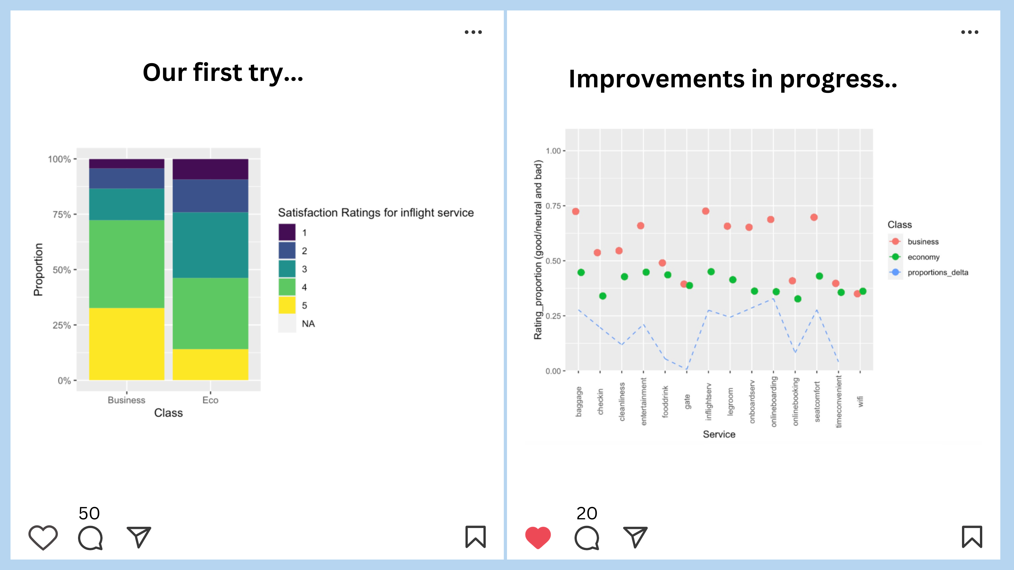
Notes:
Ideen hinter den Plots darstellen

Slide 5
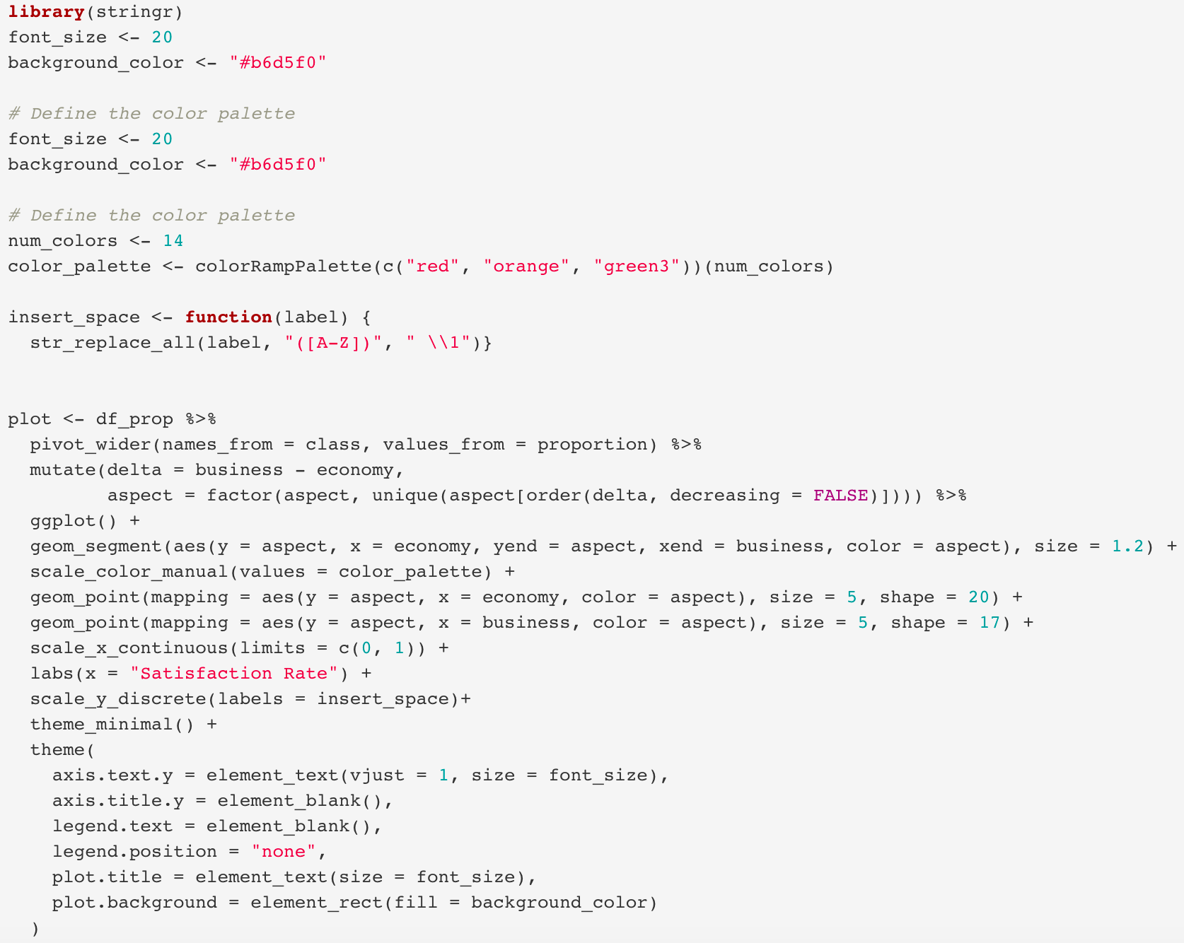

Slide 6
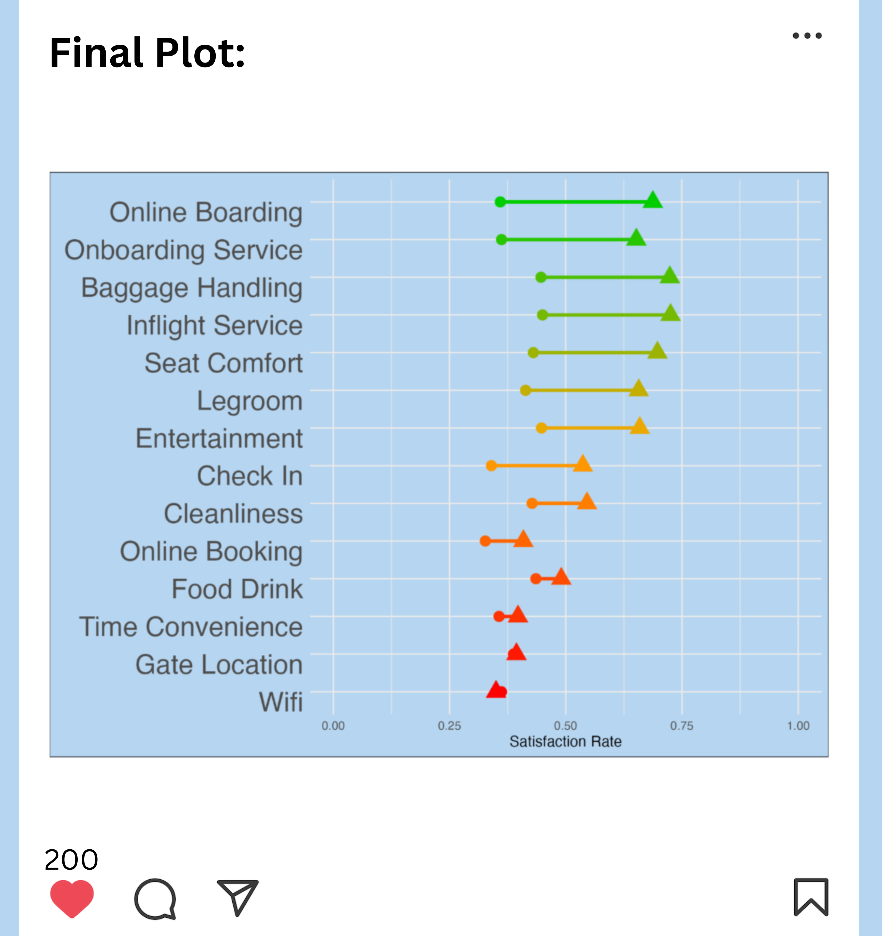
Notes:
Ideen hinter den Plots darstellen
3) Computation of porportions and deltas
We evaluated 14 different services and calculated the percentage of passengers who were satisfied or very satisfied (rated 4 or 5 on a scale) in this two classes. Then, we compared the proportions between economy and business class for each service to identify the largest differences.
Plot erklären wie er aufgebaut ist
resultate + implications & Methode

Slide 7
Limitations
Data set precovid 2015: airtravel might have changed quite a bit → prepandemic data
Limitations? Not in the final presentation but in the 10min presentation
We haven’t considered all external and internal confounding variables (such as external: socioeconomic status, purchasing power; and internal: flight distance, what the different services entail)
The Validity of the questionnaire cannot be assessed
Relektion
- Nicht immer inferenzstatistik betreiben (haben wir direkt gemacht)

